Slide 1

Presentation: EcoBikeRental Application
Group 4

Slide 2
Team assignment
No | Team member | Student ID | Assignment | Contribution
1 | Vu Thanh Hai | 20194756 | Usecase return bike | 33.333%
2 | Hoang Thi Hang | 20194757 | Usecase view dock and bike | 33.333%
3 | Nguyen Thu Hieu | 20194761 | Usecase rent a bike | 33.333%

Slide 3
Content of presentation
1. Diagrams
2. Design considerations
3. Design pattern
4. Software Design
5. Demo

Slide 4
Usecase Diagram

Slide 5
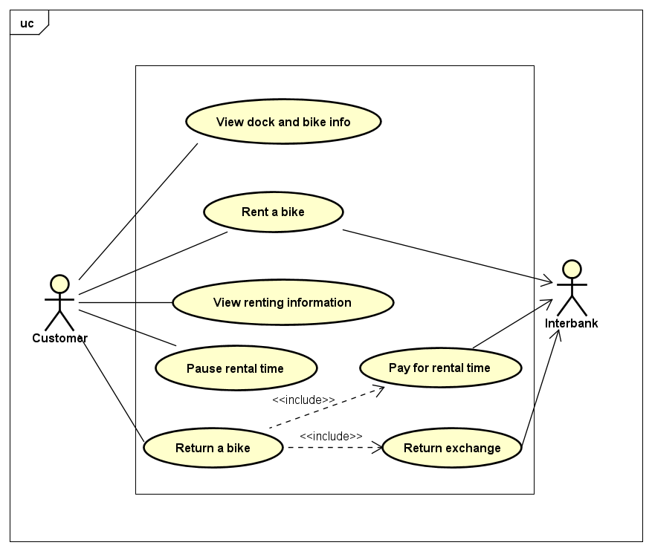

Slide 6
Class Diagram

Slide 7
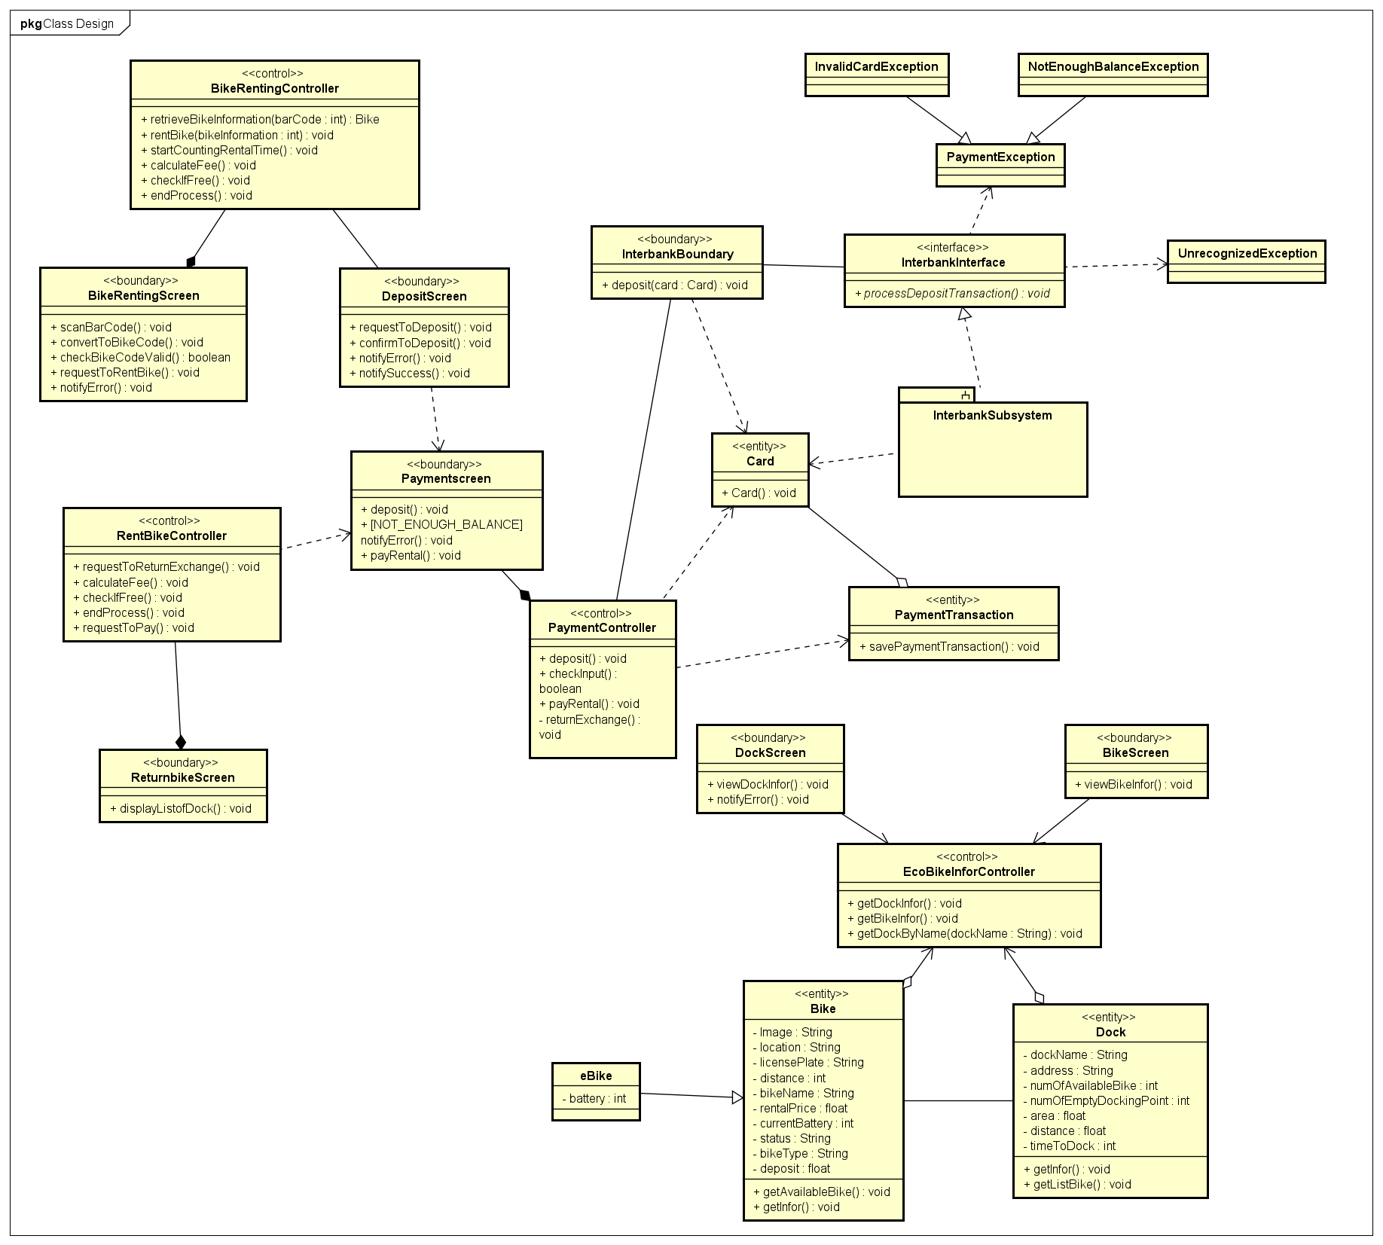

Slide 8
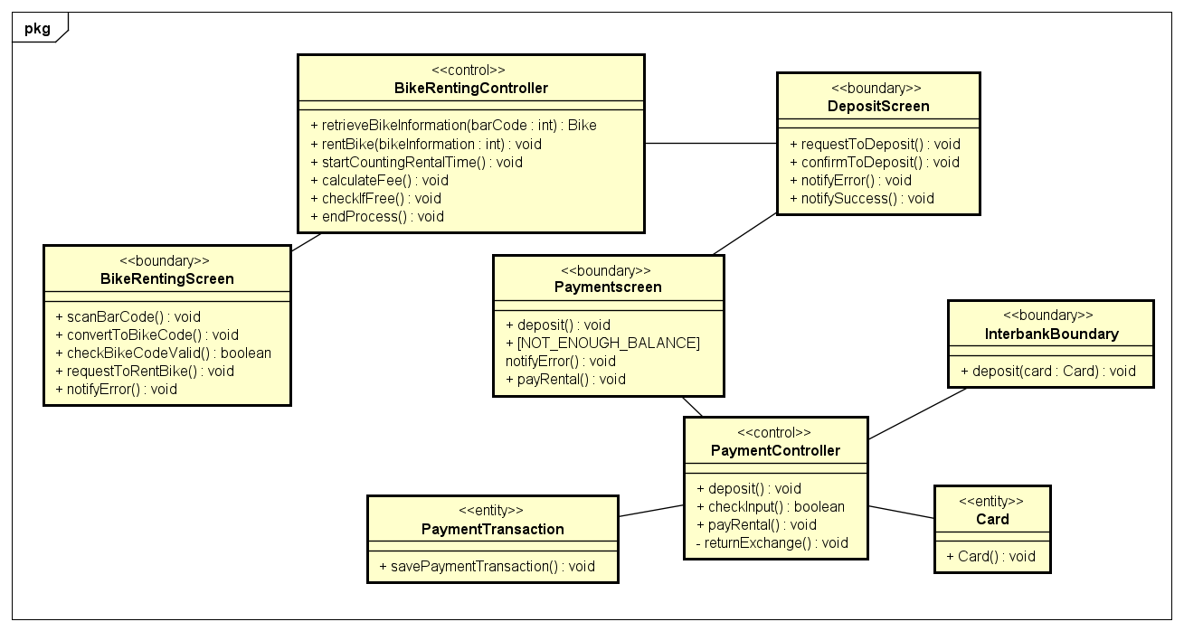
Rent a bike

Slide 9
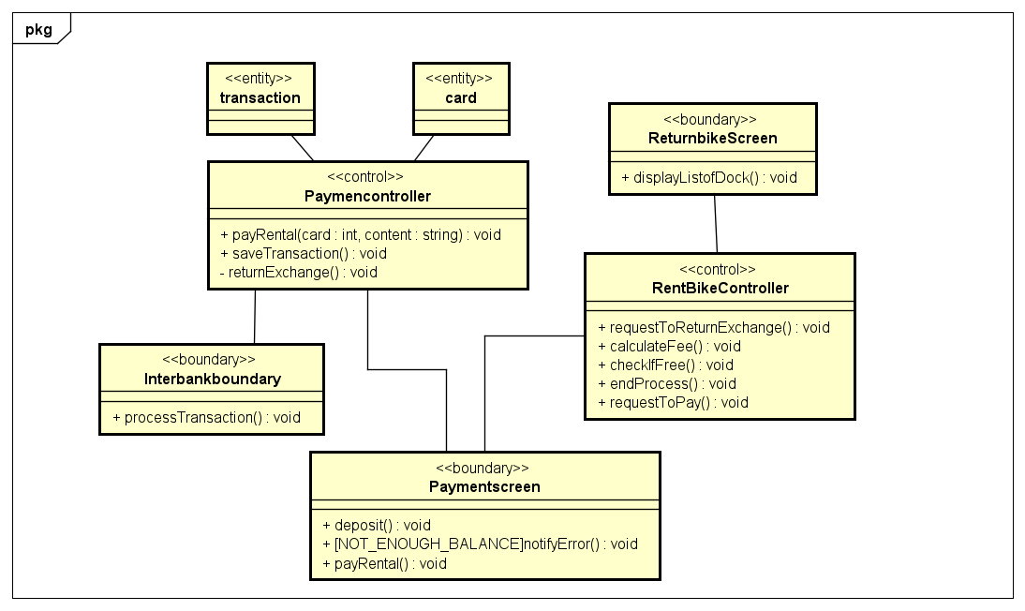
Return a bike

Slide 10
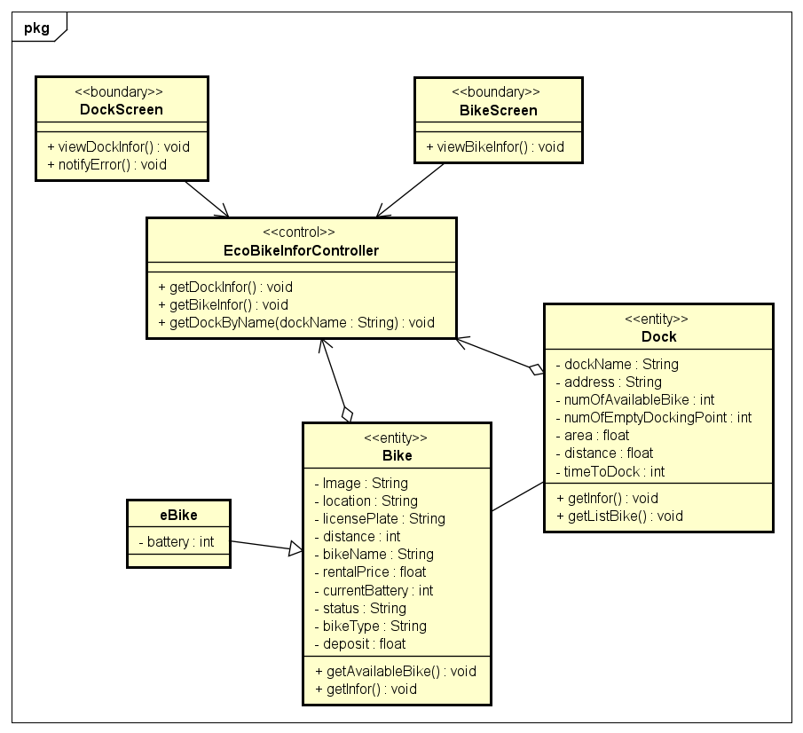
View dock and bike infor

Slide 11
Interaction Diagram

Slide 12
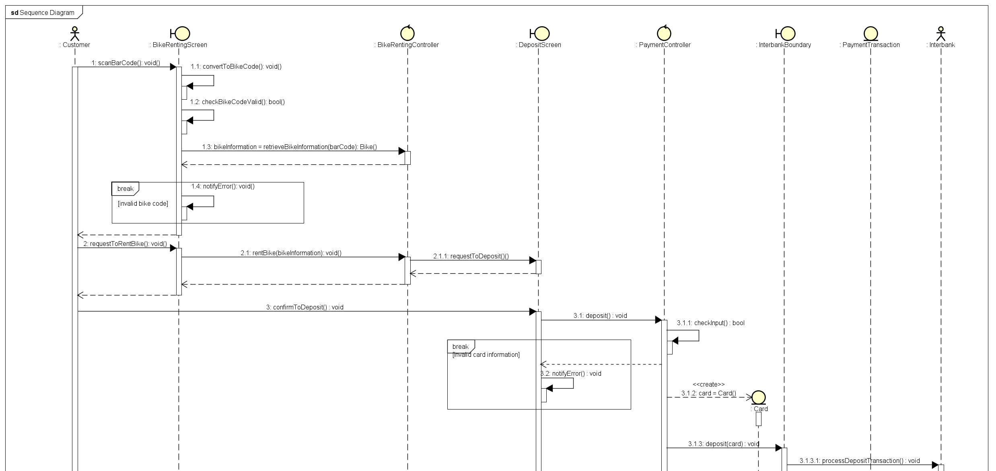
Rent a bike

Slide 13
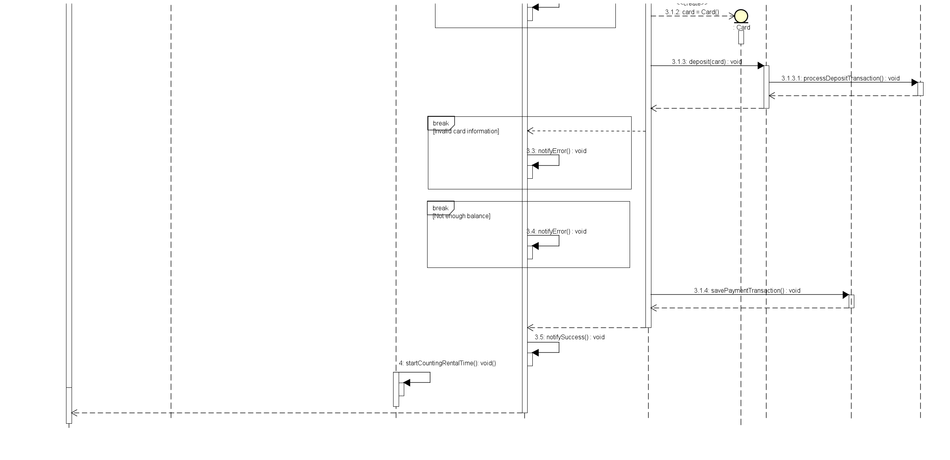
Rent a bike

Slide 14
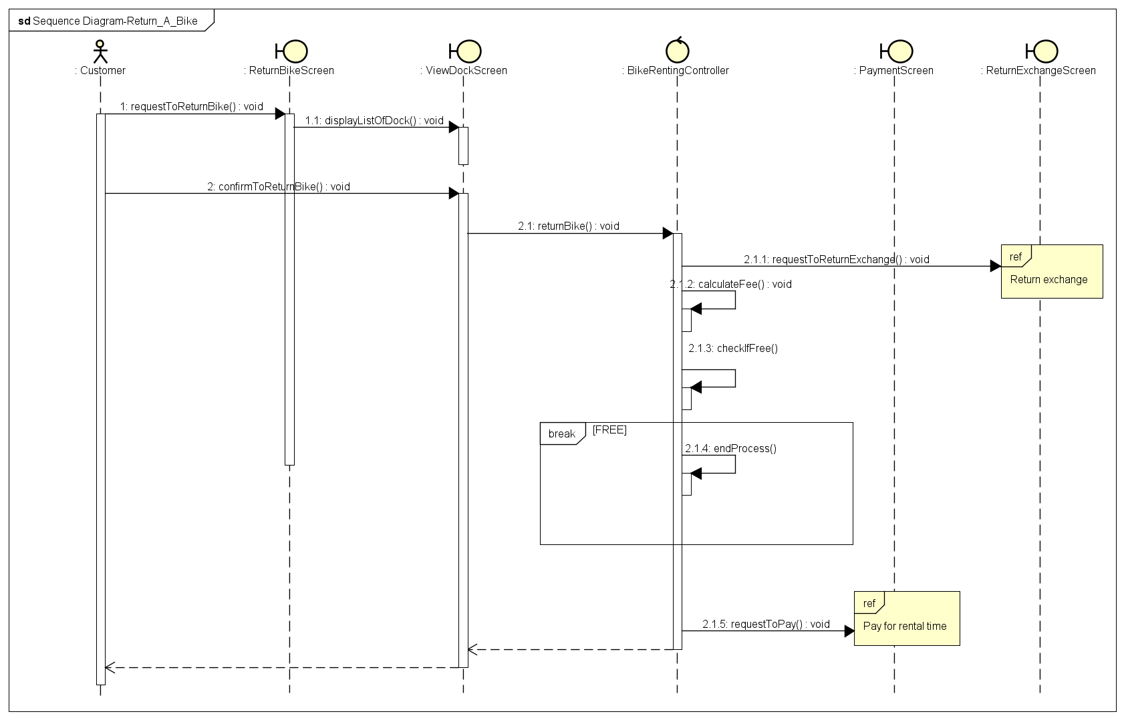
Return
a
bike

Slide 15
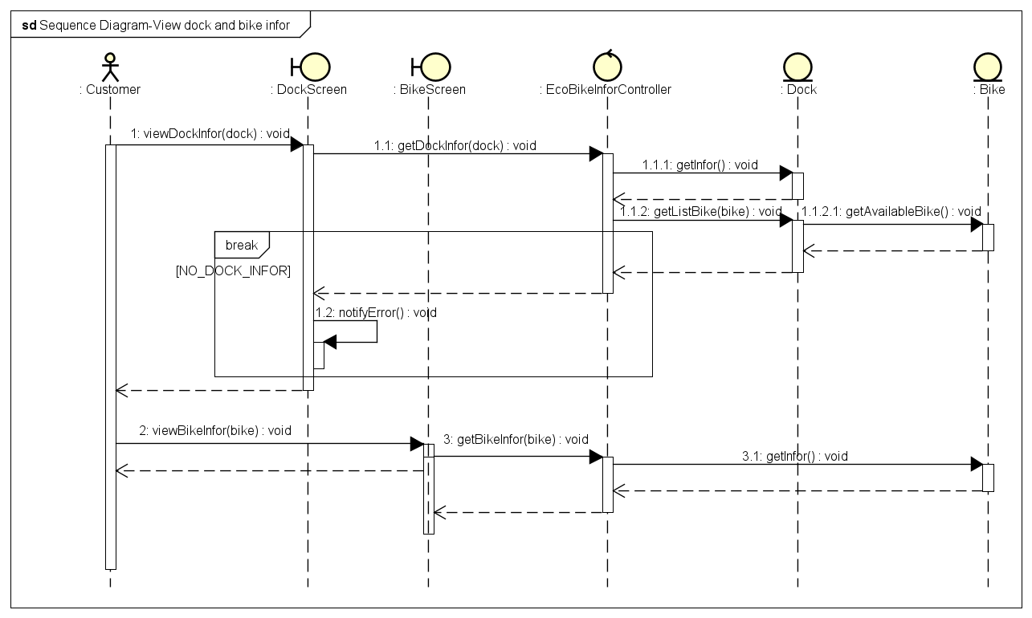
View
bike
and
dock

Slide 16
ERD Diagram

Slide 17
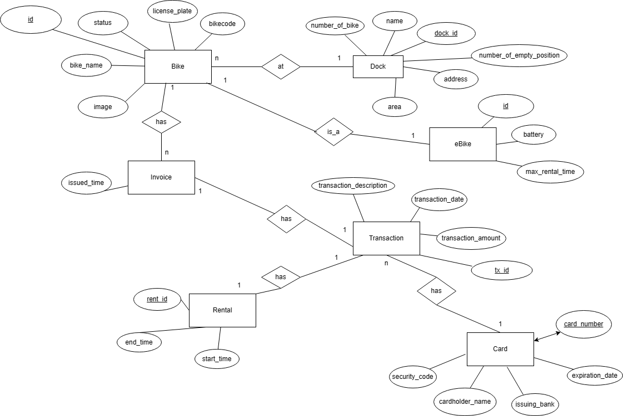

Slide 18
Design Considerations

Slide 19
Coupling
Cohesion
The project is designed following MVC architecture. Each module only depends on each other via function parameters, which make each class more independent.
=> The project is still not good enough for coupling, because many variables are still public why they can be optimized for private, which is not good for coupling.
The classes Util, GlobalStore is global and can be used by many other classes. Loops, multiple conditions and steps in the codes which is procedural cohesion and we can clearly see them. Reuse code for many function. The class in each group depend on each other closely.
=> The project is really good for cohesion.

Slide 20
Software Design
Unit Test
SQL, Java, JavaFx

Slide 21
Demo

Slide 22
Thank you for listening!

